Slide 1
Coding without code: How vibe coding rewrites the rules
Week of March 16th
Elias Hord

Slide 2
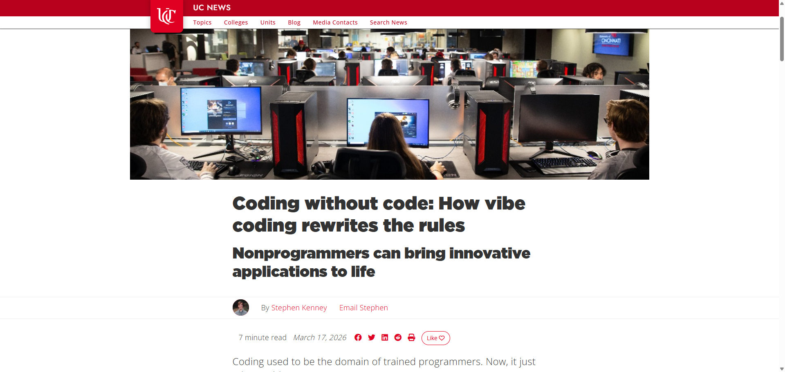
General Information
Article Publication: March 17, 2026
https://www.uc.edu/news/articles/2026/03/coding-without-code--how-vibe-coding-rewrites-the-rules.html

Slide 3
Main Findings and Arguments
“Vibe coding” = coding with natural language + AI The article explains that vibe coding allows users to create software simply by describing what they want in plain English, with AI generating the actual code. This dramatically lowers the barrier to entry for building apps and websites.
Speed and accessibility are the biggest advantages Tasks that once took months can now be completed in minutes or days. Even people without programming experience can build functional tools, making software development far more accessible.
Key use cases include automation, prototyping, and reporting Common applications highlighted:
Automating repetitive workflows
Building websites/apps quickly
Generating reports
Rapid prototyping of ideas
AI is a tool—not a replacement for expertise The article emphasizes that vibe coding should augment human teams, not replace skilled developers. Human oversight is still needed for quality, security, and scalability

Slide 4
Broader Implications for Society
Democratization of technology Vibe coding allows non-programmers to create software, shifting power from specialized developers to a broader population. This could lead to more innovation from diverse groups.
Shift in required skills The focus moves from writing code to:
Problem framing
Prompting AI effectively
Evaluating outputs This represents a major shift in what “technical literacy” means.
Faster innovation cycles Businesses and individuals can test ideas quickly, potentially accelerating entrepreneurship and digital transformation across industries.
New risks (security + reliability) The article hints that entering sensitive data into AI tools may expose vulnerabilities, and AI-generated code may not always be secure or robust—raising concerns about misuse and quality control.

Slide 5
Relevance or Potential Influence on the Construction Industry
Automation of project workflows Construction firms could use vibe coding to:
Automate reporting (progress, budgets, safety logs)
Streamline documentation processes This reduces administrative workload and improves efficiency.
Custom tools without large IT budgets Instead of buying expensive software, teams could quickly build:
Scheduling tools
Cost tracking dashboards
Site management apps tailored to specific projects.
Rapid prototyping for project planning Teams could quickly test digital solutions (e.g., dashboards, simulations) before full implementation, improving decision-making.
Lower barrier for innovation in the field Non-technical professionals (project managers, engineers) could directly create solutions, reducing reliance on specialized developers.
Caution: quality and safety concerns In construction—where mistakes are costly—AI-generated tools must be carefully validated to avoid errors in planning, budgeting, or safety systems.

